Slide 1
date: 2021-11 author: “Chéyo Jiménez, MSE” title: “Personal Journey” output: powerpoint_presentation: reference_doc: reference_one.pptx marp: true

Slide 2
What is your story?
Our professional lives are part of our life narrative. It is not the whole story.
It is up to you to control this narrative.
Notes:
~12 years as of 2021
Young professional figuring how to get paid for doing what I love
Our professional life may take different paths but the journey is the same

Slide 3
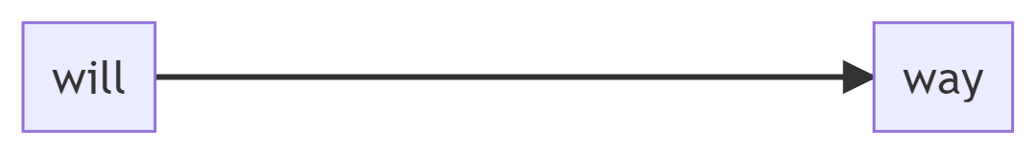
Path

Slide 4
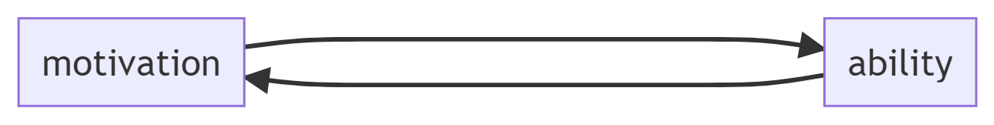
Path

Slide 5
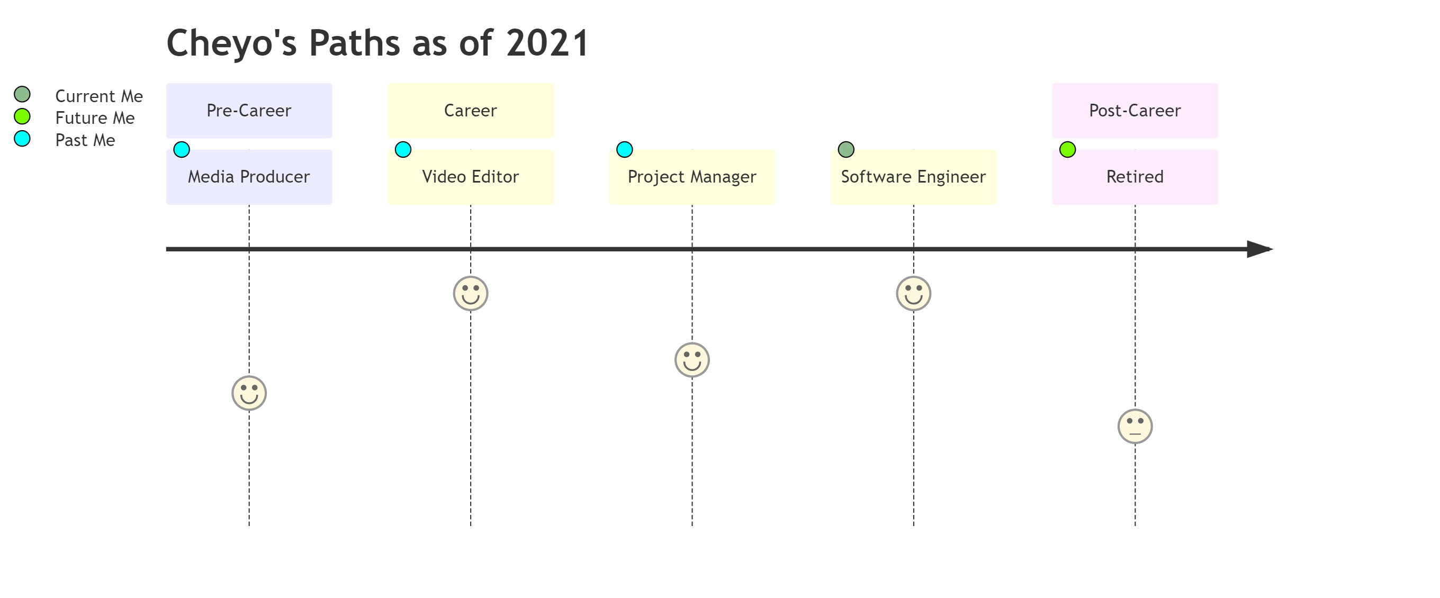
Back[Story]
Notes:
Not included here are college jobs that would not qualify. For example, working at as a package loader motivated me to not want to do that as a career. The same goes for summer helping family with home construction projects.

Slide 6
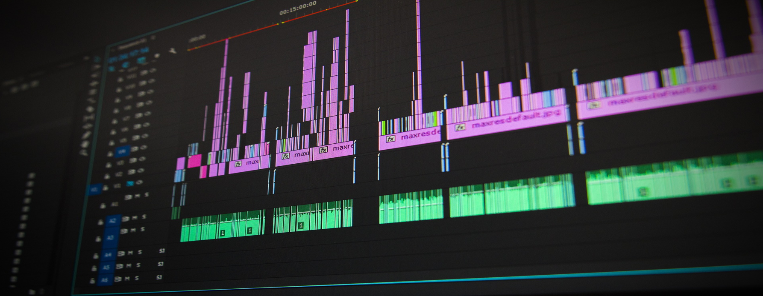
Video Editor at NonProfit
Notes:
Motivation: Helping people in need and getting other people to help. Different than most traditional non profits.
Ability: Creating digital artifacts to get more people involved in helping people.
Learnings: How to work hard (Ability). Aligned to the mission (Motivation). Leadership and confidence (Motivation)

Slide 7

Project Manager at Portable Buildings Company
Notes:
Motivation: I was creating less and less digital content that I thought it might be better for me to switch career where they may be better pay.
Ability: Work hard. Leadership and confidence. Support sales people to sell more structures.
Learnings: International Travel is overrated. A company (where you work) should not be part of your identity. Money as a primary motivation did not work for me.

Slide 8

Software Engineer at Tech Company
Notes:
Motivation: I love to code.
Ability: Create clarity from ambiguity. All previous abilities.
Learnings: More money doesn’t remove career angst. Constant Mastery > arriving. Enjoy the journey > getting to a destination.

Slide 9
Path

Slide 10
Narrative
“If a tree were to fall on an island where there were no human beings would there be any sound?” https://en.wikipedia.org/wiki/If_a_tree_falls_in_a_forest

Slide 11
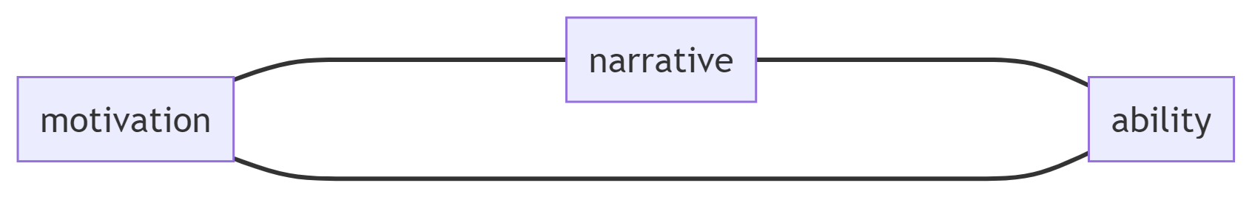
Path

Slide 12
Narrative Context
Back[Story]: Past (Also History)
Story: Current (Learnings)
User[Story]: Future (similar to Agile)

Slide 13
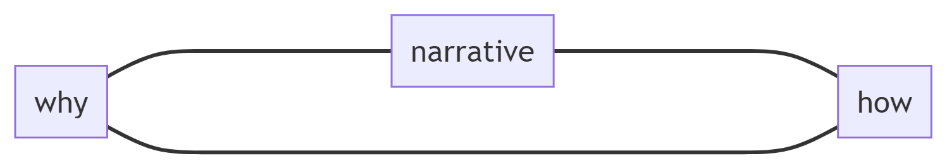
Narrative/Context
Notes:
It is the manifestation of your why you did something. Why you do what you do. Why will you do it again in the future.
It is the story of how you did something. How you are doing that thing now. And how you plan to improve.
It is socializing ideas. Building communities. Leaving your mark in this world.

